Slide 1
Generics in Java

Slide 2
What is Generics in Java?
Generics is a term that denotes a set of language features related to the definition and use of Generic types and methods. Java Generic methods differ from regular data types and methods. Before Generics, we used the collection to store any type of objects i.e. non-generic. Now, Generics force the Java programmer to store a specific type of objects.
Now that you know what is Generics in Java, let’s move further and understand why do you need Java Generics.

Slide 3
Why Java Generics?
If you look at the Java collection framework classes, then you will observe that most classes take parameter/argument of type Object. Basically, in this form, they can take any Java type as argument and return the same object or argument. They are essentially heterogeneous i.e. not of a similar type.

Slide 4
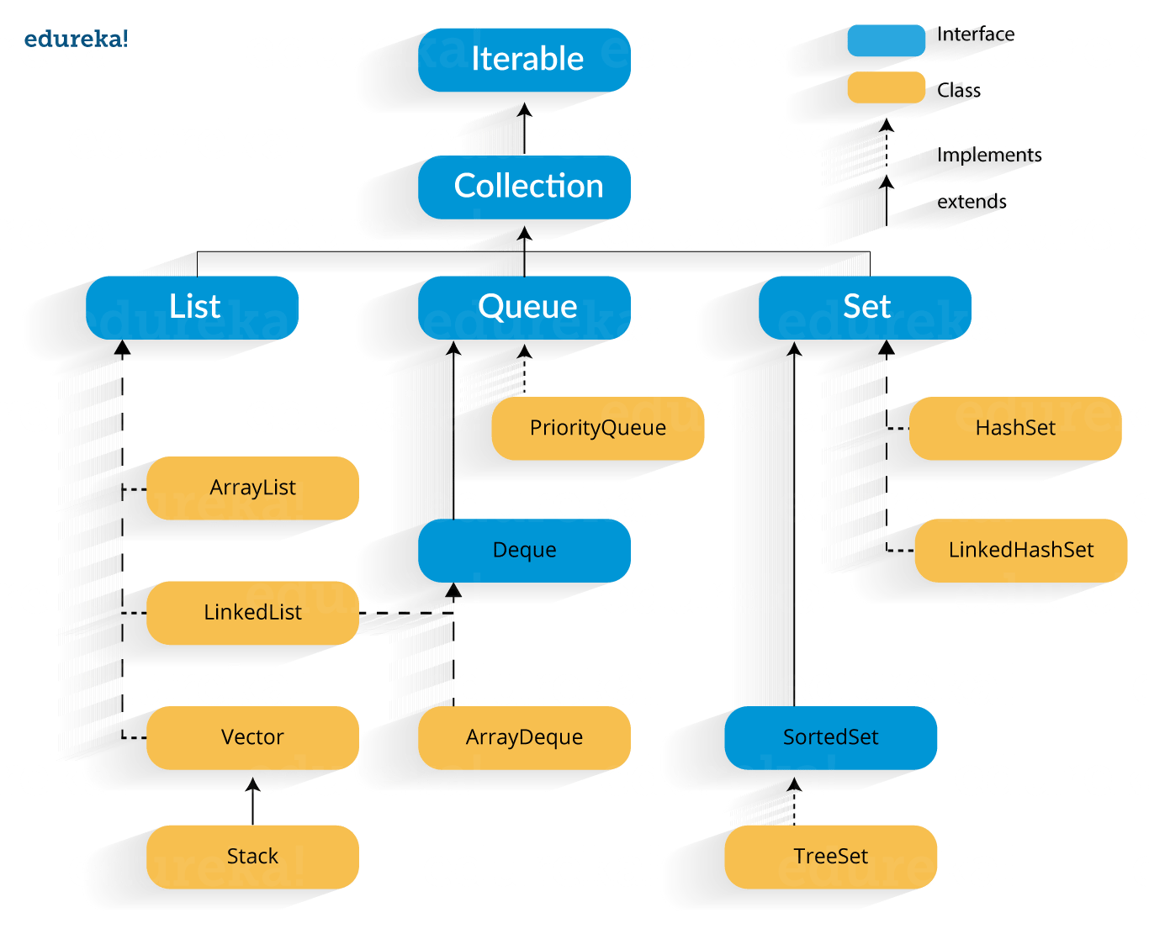

Slide 5
Sometimes in the Java application, the data type of the input is not fixed. The input can be an integer, a float or Java string. In order to assign the input to the variable of the right datatype, prior checks had to be conducted. In the traditional approach, after taking the input, the datatype of the input was checked and then was assigned to the variable of the right datatype. When this logic was used, the length of the code and execution time was increased. To avoid this, Generics were introduced. When you use Generics, the parameters in the code is checked at compile time automatically and it sets the datatype by default. So this is where you need the concept of generics in Java.

Slide 6
How Generics can be applied to the source code.
Types of Java Generics
There are 4 different ways Generics can be applied to in Java and they are as follows:
Generic Type Class
Generic Interface
Generic Method
Generic Constructor

Slide 7
1. Generic Type Class
A class is said to be Generic if it declares one or more type variables. These variable types are known as the type parameters of the Java Class. Let’s understand this with the help of an example. In the below example, I will create a class with one property x and type of the property is an object.
class Genericclass{
private Object x;
public void set(Object x) { this.x = x; }
public Object get() { return x; }
}

Slide 8
Here, once you initialize the class with a certain type, the class should be used with that particular type only. E.g. If you want one instance of the class to hold the value x of type ‘String‘, then programmer should set and get the only String type. Since we have declared property type to Object, there is no way to enforce this restriction. A programmer can set any object and can expect any return value type from get method since all Java types are subtypes of Object class.

Slide 9
To enforce this type of restriction, we can use generics as below:
class Genericclass<X> {
//T stands for "Type"
private T x;
public void set(T x) { this.x = x; }
public T get() { return x; }
}
Now you can be assured that class will not be misused with wrong types. A simple example of “Genericclass” looks like as shown below:
Genericclass<String> instance = new Genericclass<String>();
instance.set(“MCAIII");
instance.set(10); //This will raise compile time error
So that’s how it works. This analogy is true for the interface as well. Let’s quickly look at an example to understand, how generics type information can be used in interfaces in java.

Slide 10
Generic Interface
//Generic interface definition
interface GenericInterface<T1, T2>
{
T2 PerformExecution(T1 x);
T1 ReverseExecution(T2 x);
}
//A class implementing generic interface
class Genericclass implements GenericInterface<String, Integer>
{
public Integer PerformExecution(String x)
{
//execution code
}
public String ReverseExecution(Integer x)
{
//execution code
}
}

Slide 11
Advantages of Generics in Java
1. Code Reusability
You can compose a strategy or a class or an interface once and use for any type or any way that you need.
2. Individual Types Casting isn’t required
Basically, you recovered information from ArrayList every time, you need to typecast it. Typecasting at each recovery task is a major migraine. To eradicate that approach, generics were introduced.
3. Implementing a non-generic algorithm
It can calculate the algorithms that work on various sorts of items that are type safe as well.

